Slide 1
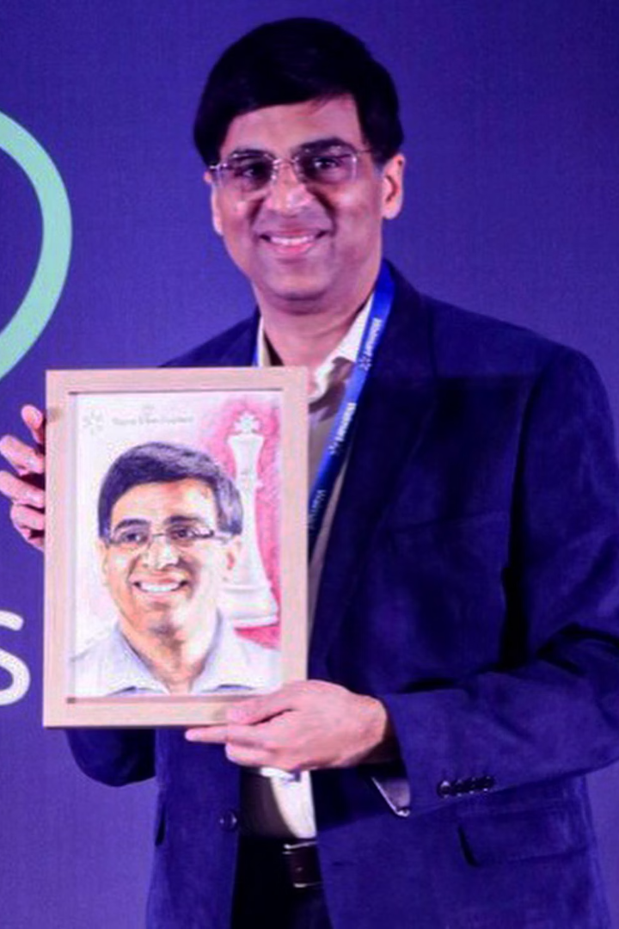

Vishwanathan Anand: The Pride of Indian Chess
Vishwanathan Anand, India's first Grandmaster, is an inspiration to millions. He is a five-time World Chess Champion. He has inspired generations with his brilliance, humility, and sportsmanship.
by Krishnaraj

Slide 2
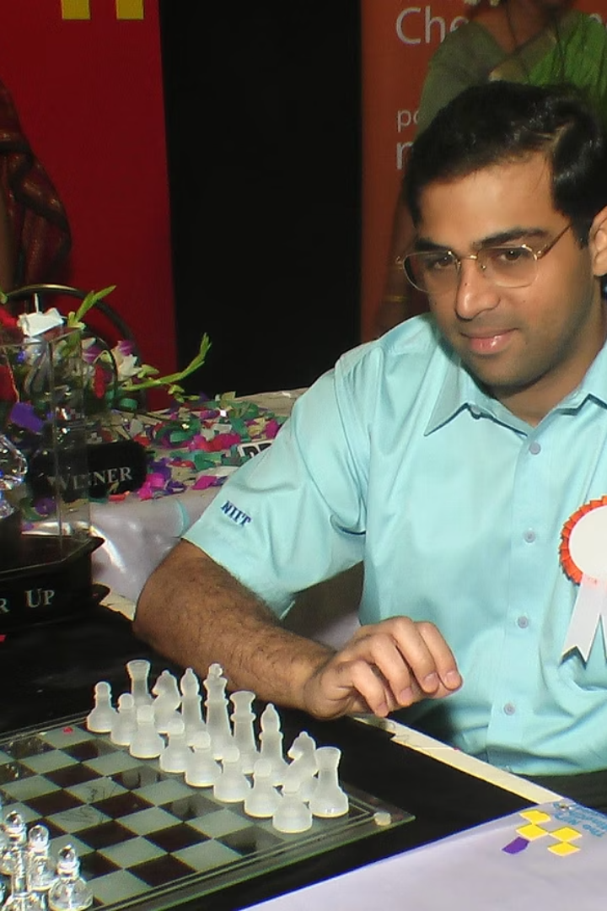
Early Life and Rising Star
1
Born in Tamil Nadu
2
Chess Prodigy
Anand was born in Mayiladuthurai, Tamil Nadu, in 1969.
He learned chess at age 6. He won the sub-junior championship at age 14.
3
International Recognition
He became an International Master at 15.

Slide 3
World Champion and Unrivaled Dominance
First Asian Champion
Undisputed Champion
Title Defenses
In 2000, Anand became the first Asian to win the World Championship.
He held the undisputed World Chess Champion title from 2007-2013.
He successfully defended his title against Kramnik, Topalov, and Gelfand.

Slide 4




Honors and Prestigious Recognition
Padma Shri
Received at age 18.
Padma Vibhushan
Awarded in 2007.
Chess Oscar
Six-time recipient.

Slide 5



Anand's Inspiring Style
Versatility
Adaptable to any opponent.
Rapid Decision-Making
Quick and precise moves.
Intuitive Strategy
Understands the game deeply.

Slide 6
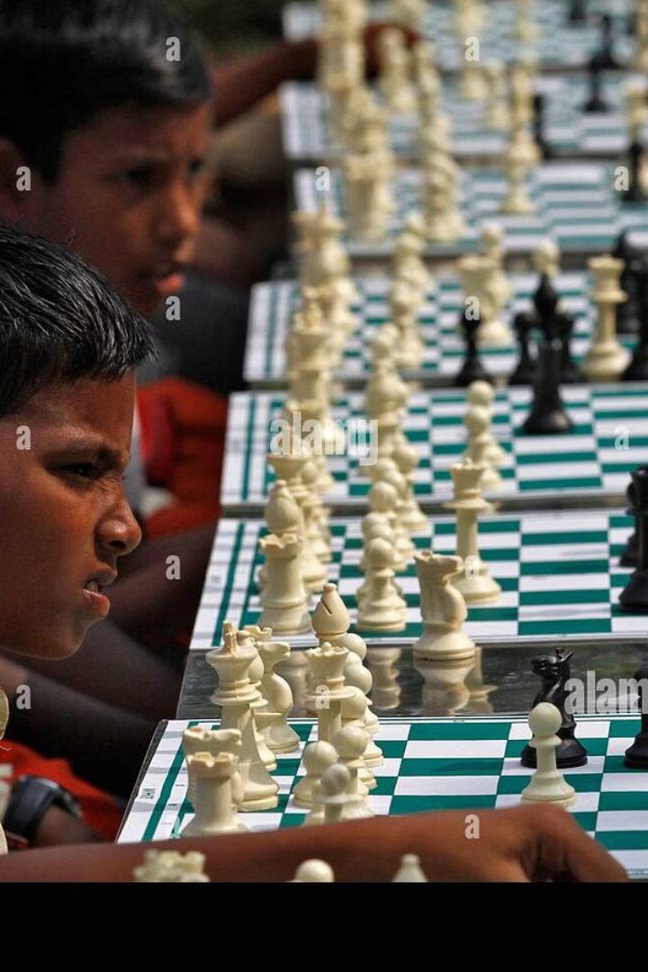



Contributions to Chess and Education
Grassroots Promotion
Promoted chess in India.
NIIT Mind Champions Academy
Associated with educational initiatives.
Values Advocate
Advocated for cerebral and sportsmanship values.

Slide 7






Life Lessons from Viswanathan Anand
Humility
Despite success, stay humble.
Perseverance
Through defeat, learn and adapt.
Learning
Always emphasize learning and growth.

Slide 8
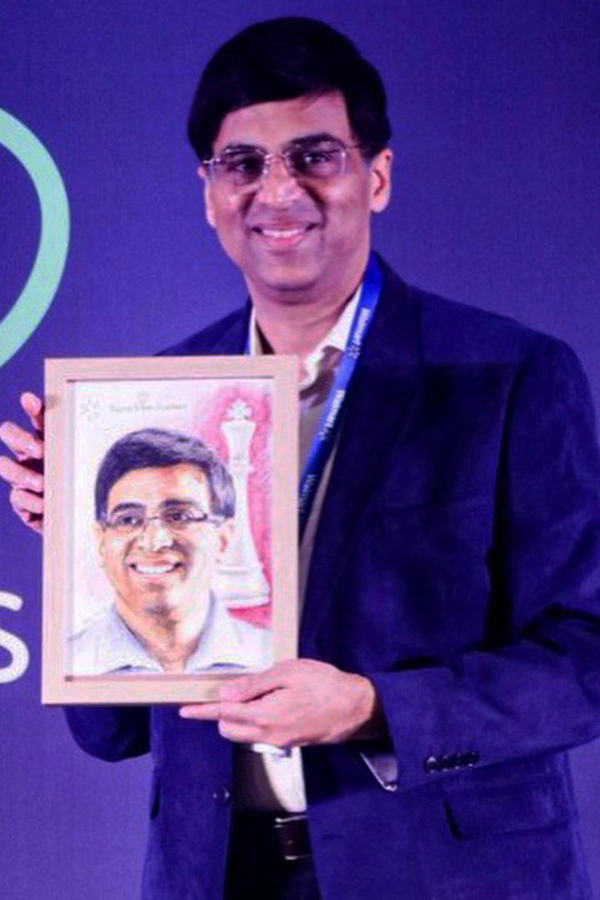
The Enduring Legacy of Viswanathan Anand
5
1
World Titles
Pioneer
Millions
Inspired
Anand's journey teaches lifelong lessons in discipline and resilience. He has inspired millions with his achievements.

